Slide 1


LinkedIn Job Trends VS Skill Analysis
GOTLA SREETHA
LAGGISETTY DHARSHINI
GIRIPOGU NEHA MARK
TALAGADADEEVI SAI NIKHIL

Slide 2

CONTENTS
Introduction
Abstract
System Requirements
Architechture
Advantages
conclusion

Slide 3

INTRODUCTION

Slide 4

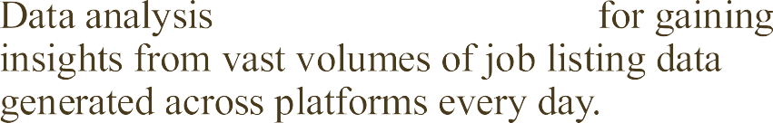


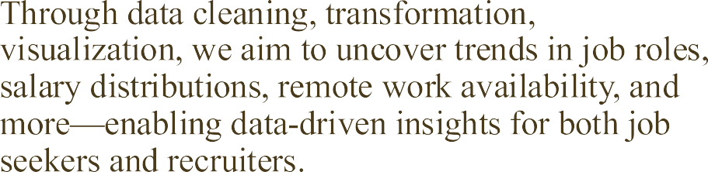

INTRODUCTION

Slide 5

ABSTRACT

Slide 6
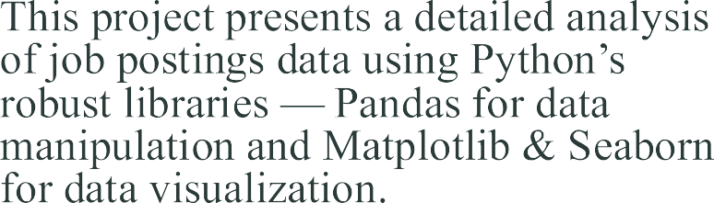
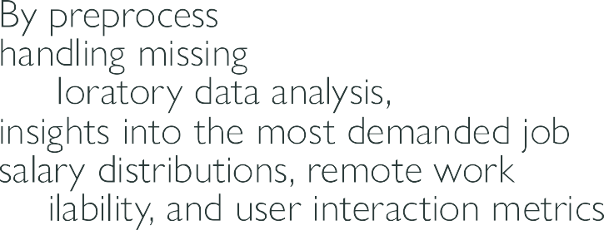




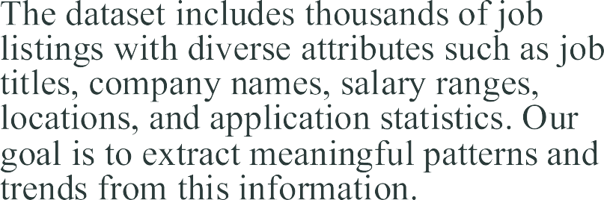

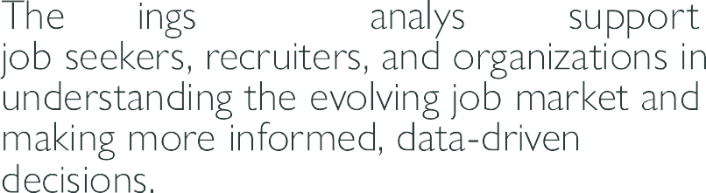

ABSTRACT

Slide 7
SYSTEM REQUIREMENTS

Slide 8












































SYSTEM REQUIREMENTS

Slide 9
PROJECT ARCHITECTURE

Slide 10
Data Importing & Collection
Imported LinkedIn job postings dataset using Pandas
Dataset contains: job titles, salaries, locations, experience levels, company names, work types, etc.
Tool used: pandas.read_csv()
import pandas as pd
df = pd.read_csv('/content/postings.csv', on_bad_lines='skip')

Slide 11
Data Exploration
Explored structure, size, columns, datatypes
Identified missing values, value counts, and basic statistics
df.head()
df.info()
df.describe()

Slide 12
Data Cleaning & Preprocessing
Explored structure, size, columns, datatypes
Identified missing values, value counts, and basic statistics
df.head()
df.info()
df.describe()

Slide 13
Data Grouping & Aggregation
Grouped job postings by title and city
Found top job titles and cities with most postings
Used value_counts() for rankings
top_titles = df['title'].value_counts().head(10)
top_cities = df['location'].apply(lambda x: x.split(',')[0]).value_counts().head(10)

Slide 14
Data Visualization
Created bar charts, pie charts, and heatmaps
Visualized:
Salary Distribution
Remote Work Availability
Top Job Titles
Top Hiring Cities
Correlation between salary and other features
Libraries Used : seaborn , matplotlib
sns.barplot(x=top_titles.values, y=top_titles.index)
plt.title("Top Job Titles")

Slide 15
ADVANTAGES

Slide 16
ADVANTAGES
1. Data-Driven Insights Helps identify in-demand job titles, top hiring cities, and remote job availability, enabling career planning and business strategy.
2. Salary Transparency Analyzing salary distribution (min, max, normalized) gives realistic expectations for different roles and locations.
3. Location Intelligence Reveals which cities have the highest number of job postings, useful for job seekers, recruiters, and relocation decisions.
4. Skill & Role Trends Understanding top job titles and experience levels helps identify trending roles in the job market.
5. Remote Work Awareness Shows how flexible job roles are with respect to remote opportunities, helping candidates target remote-friendly industries.
6. Visual Exploration Clear, easy-to-read charts and plots using Seaborn and Matplotlib make it simple to draw meaningful conclusions.
7. Scalable and Reusable Code Python scripts and analysis can be reused or scaled to other datasets or updated with new data easily.

Slide 17
CONCLUSION

Slide 18
CONCLUSION
The LinkedIn Jobs vs Skills Analysis project successfully demonstrates how data science can be used to explore the job market effectively.
🔹 We imported, cleaned, and analyzed real job posting data using Python libraries like Pandas, Seaborn, and Matplotlib.
🔹 Our focus was on key areas such as salary distribution, job title trends, remote work flexibility, top hiring cities, and correlation analysis.
🔹 The project provided valuable insights that can benefit:
Job seekers (to find high-demand roles and cities),
Recruiters (to understand market competition),
Analysts (to track workforce trends over time).
🔹 This project sets a strong foundation for more advanced applications like:
Predicting job market demand,
Matching skills with roles using NLP,

Slide 19
Thank you
TEAM NUMBER 131

